Slide 1

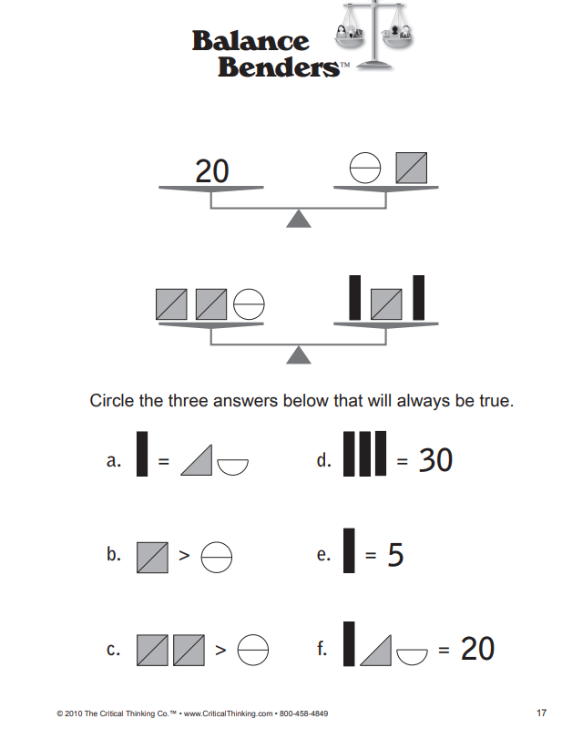
Parent Engagement Session
Characteristics of GT Learners and Resources
March 22, 2022
Are you smarter than a 3rd grader?
What were your thoughts when you saw the task?
Are you feeling overwhelmed or anxious about the task?
How did the multiple choices help you to complete the task?

Slide 2
Agenda
Welcome Activity
Introductions
  Mrs. Beth Cooper (3rd grade)
  Mrs. Angela Petty (4th grade)
  Mrs. Lynn Johnson (5th grade)
  GT Curriculum Maps (developed with Dr. Kimberley Chandler: Curriculum Director at the Center for Gifted Education at The College of William and Mary)
  Perfectionism and gifted students
  Underachievement and gifted students
  Building rigor
  Growth Mindset in gifted students
  Social/Emotional Needs of gifted students
  Parenting a gifted child
  Closing

Slide 3
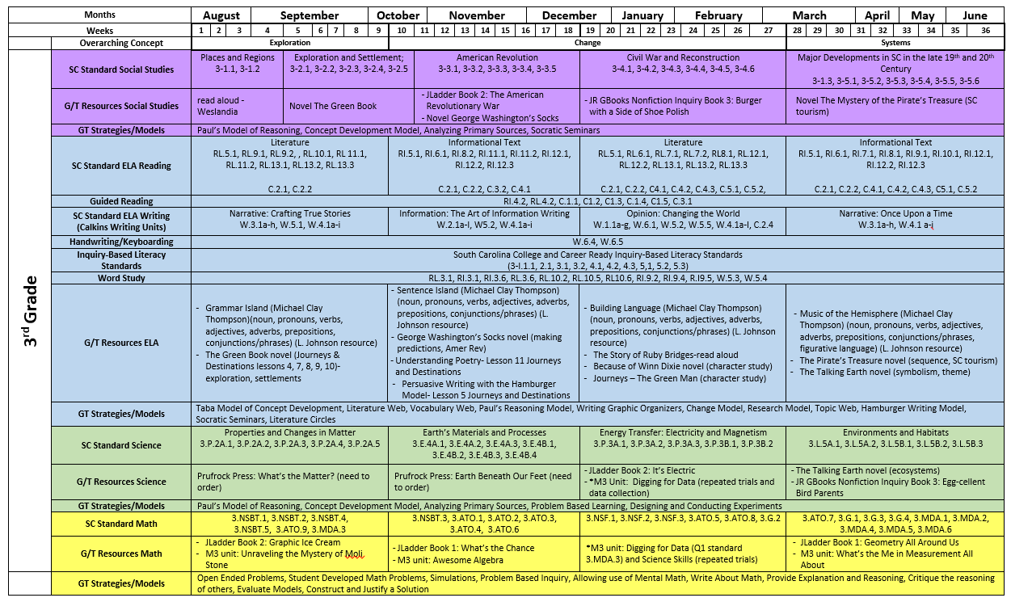

Slide 4
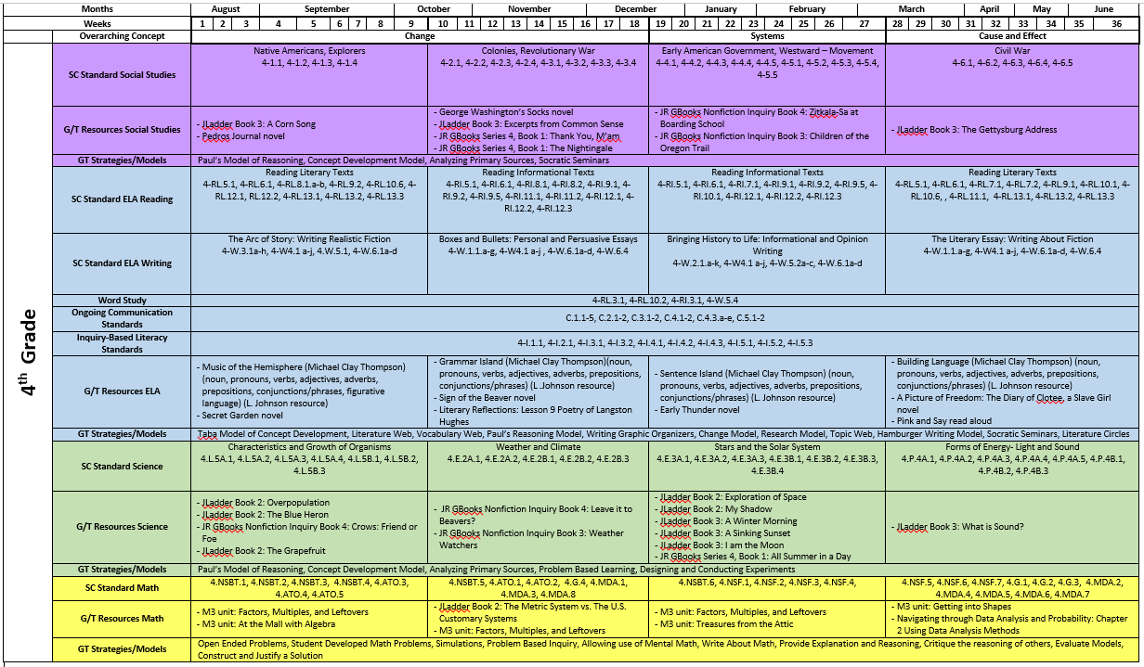

Slide 5
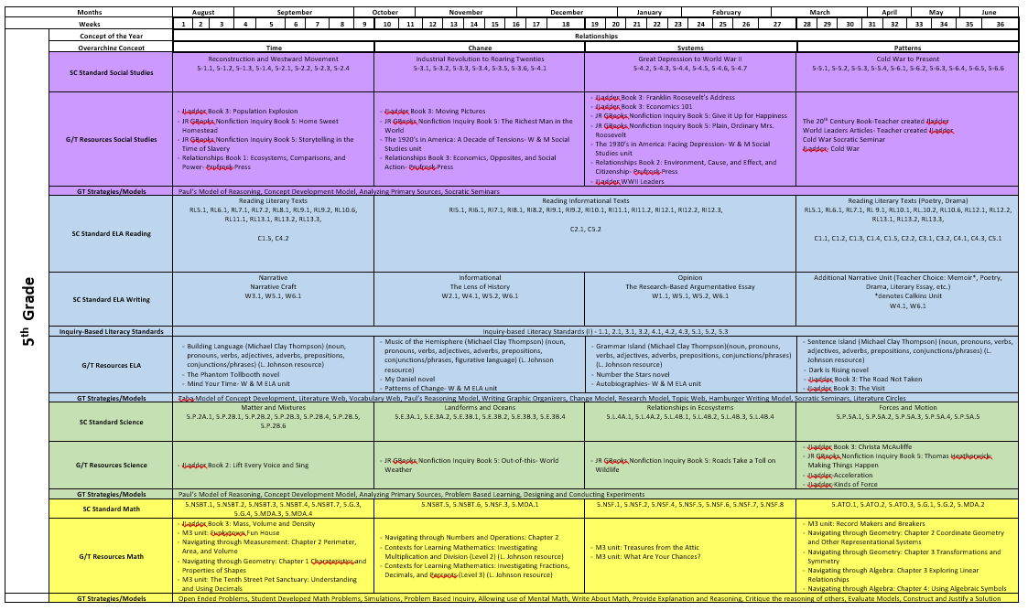

Slide 6
Realistic Learning Goals to Manage Perfectionism
According to the National Association for Gifted Children, nearly 20% of gifted students can suffer from perfectionism.
Unhealthy behaviors may include stress, overwhelming feeling of hopelessness, procrastination, underachievement.
Helping students manage perfectionism:
- Model mistakes as learning opportunities and evaluate growth.
- Track growth and take pride in the process of learning.
- Divide large tasks into smaller sections and set timelines for completion.

Slide 7
Underachievement
Some GT students may be identified as having high abilities, but low achievement levels. Psychological factors often are underlying causes. (VanTassel Baska et al, 1994)
Students should see the value in schoolwork and have positive learning models and support (through curriculum materials).
Differentiation in curricula encourages creativity, stimulates open-ended responses, and provides high-level choices. (Jaworowski, 2018)

Slide 8
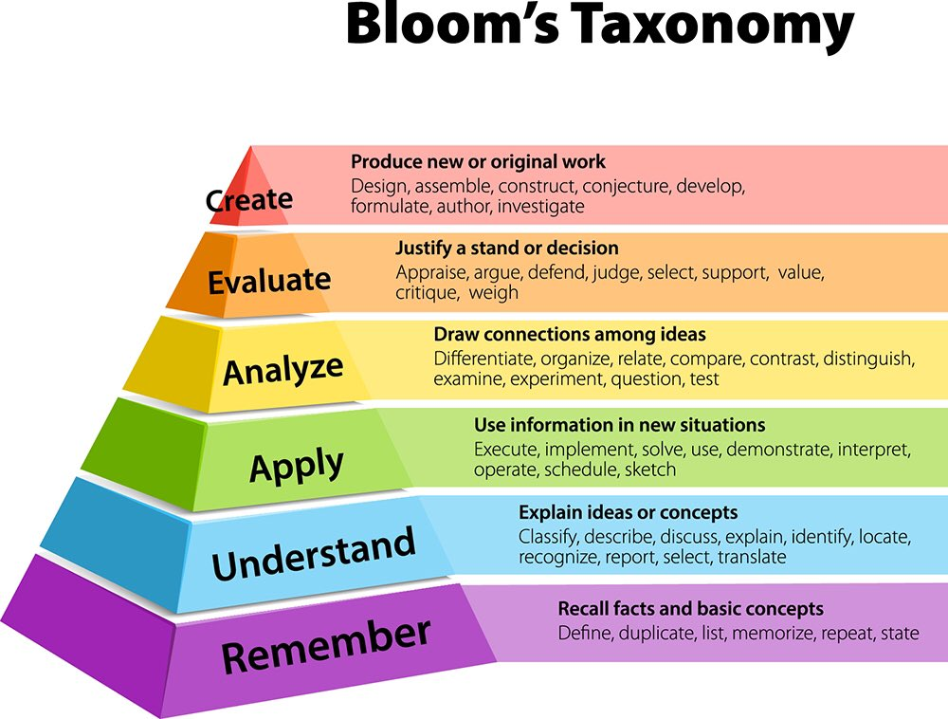
Rigor in education – intellectually challenging, thought provoking, reflective experiences
Higher order thinking processes are guided by questioning techniques.
Student sharing and reflection are supported by the teacher.
Rubrics or standards-based assessment tools are utilized.
Depth of Knowledge (DOK)
Examples
  DOK 1 – Recall facts, calculate, label (recall, reproduce)
  DOK 2 – What is your prediction and why? How would you organize these facts? (developing skills and concepts)
  DOK 3 – What is the theme or lesson in the passage? How can you prove that your solution is reasonable? (strategic thinking and reasoning)
  DOK 4 – Can you propose an alternative solution? Do you agree with the character’s actions? What evidence would you cite to defend the actions of…? (extended thinking)

Slide 9
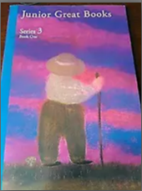
How do we increase rigor for GT students? - by using developmentally appropriate, research-based curricula
Junior Great Books – culturally diverse literary passages and Nonfiction Inquiry
Jacob’s Ladder – fables, non-fiction, and poetry with questions that increase in intensity
Project M3 “Mentoring Mathematical Minds” – use scenarios and hands-on materials to develop discussions about mathematical concepts
Hands-On Equations- uses the visual and kinesthetic instructional approach developed by Dr. Henry Borenson to demystify abstract algebraic concepts.
Differentiated Instruction -IXL and Dreambox
Genius Hour
William & Mary Curriculum
Project Based learning/Inquiry Based learning
Research Opportunities

Slide 10
Gifted Resources
    Khan Academy
    Hands on Equations
    Jacob’s Ladder
    Project M2 & M3
    William & Mary Units
    Navigators
    Jr. Great Books/Nonfiction Inquiry
    Vocabulary & Grammar Workshop
    Novel Stories
    SC Studies Weekly Magazine
    Story Works and Dynamath Scholastic Magazines
    USA Studies Weekly Magazines
    Primary Thinking Skills
    Critical Thinking Skills
    Origo Algebra for All
    Analogies

Slide 11
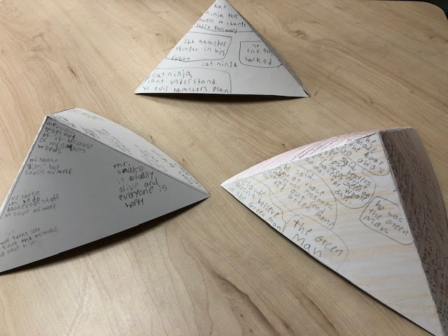
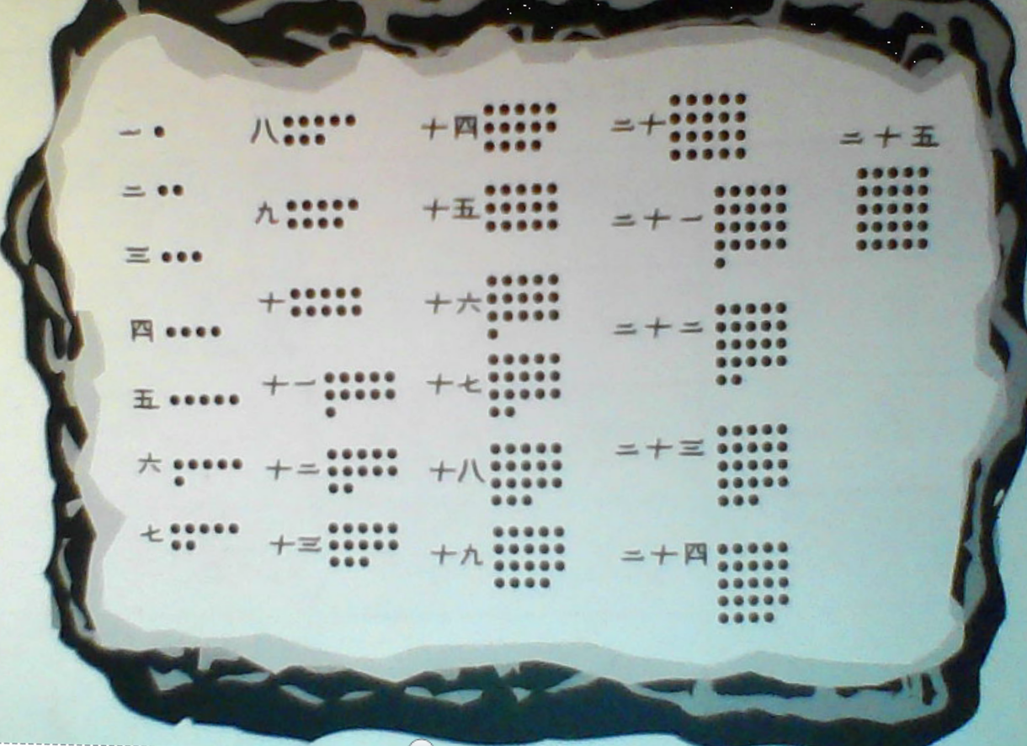
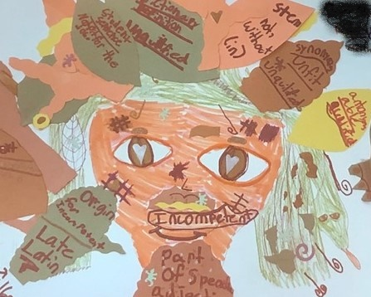
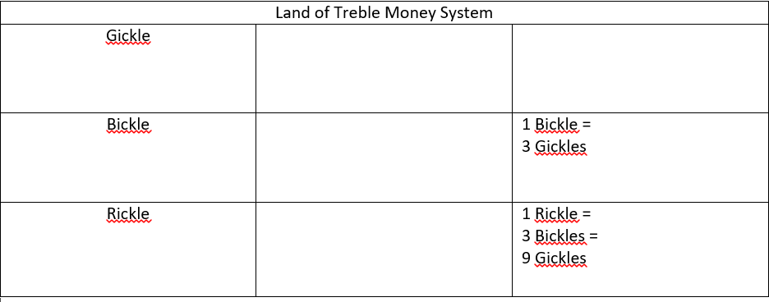
JGB “The Green Man” & M3 “MoLi Stone”
Evaluating numeration systems
Vocabulary Web
Cross-text synthesis using story mountains

Slide 12
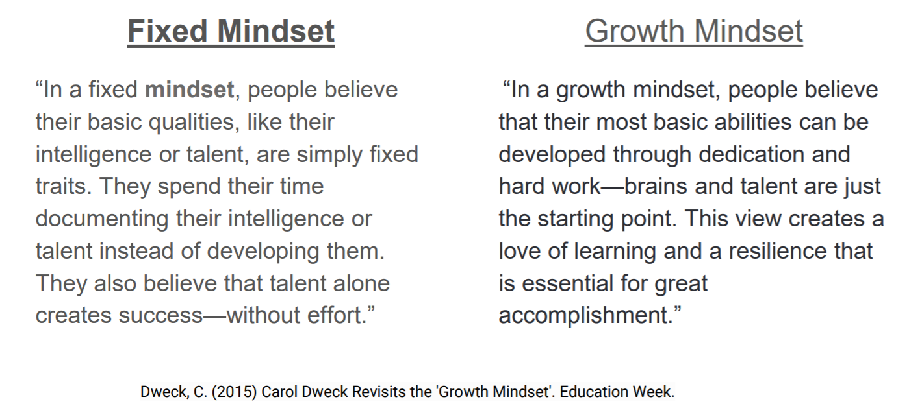
Carol Dweck’s Mindsets
An overview

Slide 13
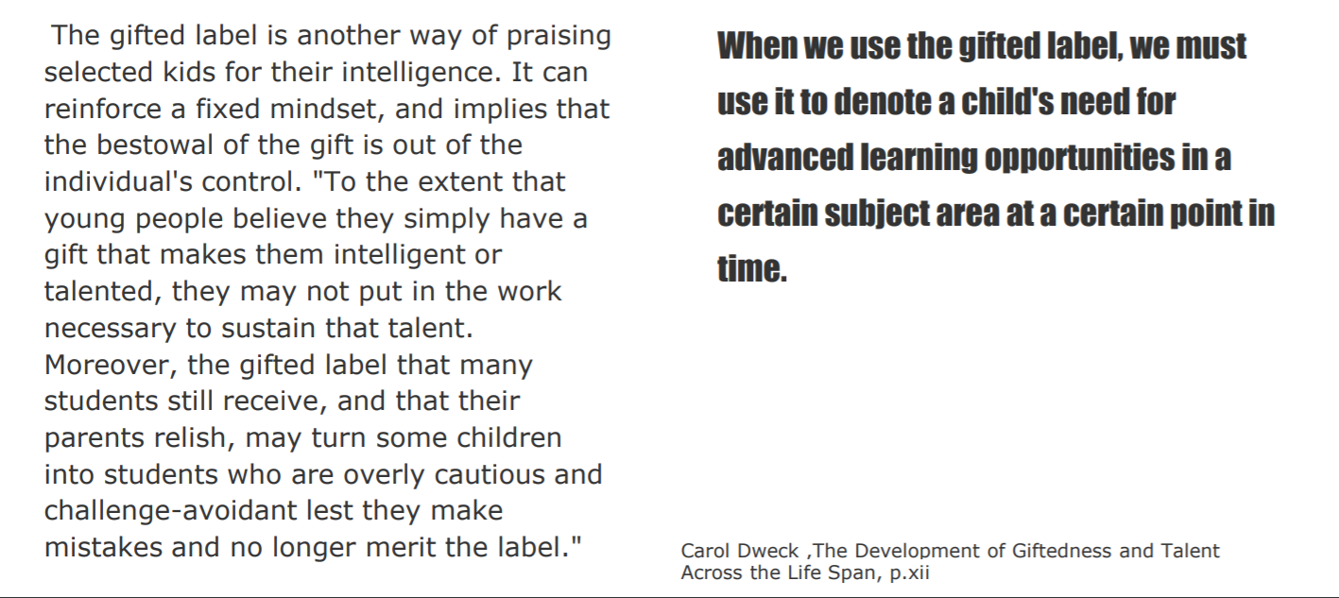
How does this apply to the gifted child?

Slide 14
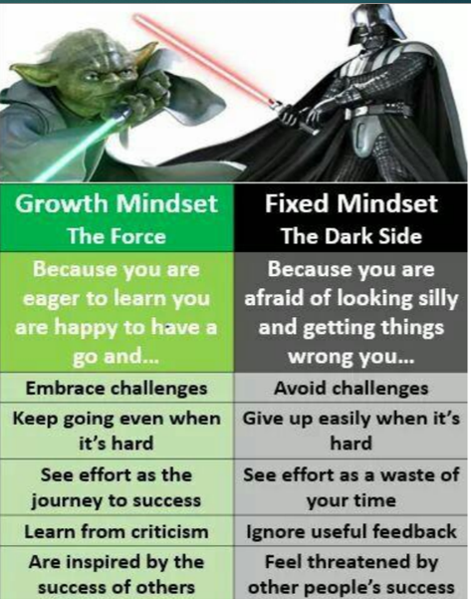
How does Growth Mindset apply?
Let’s break it down.
Gifted Students sometimes…
Are perfectionists
Avoid challenges/underachieve
Are jealous of others’ success
Are disorganized
Are highly sensitive/emotional
Have difficulty relating to peers
Are overly concerned with fairness
Lack physical dexterity
Perseverate on a single topic
Have asynchronous development

Slide 15
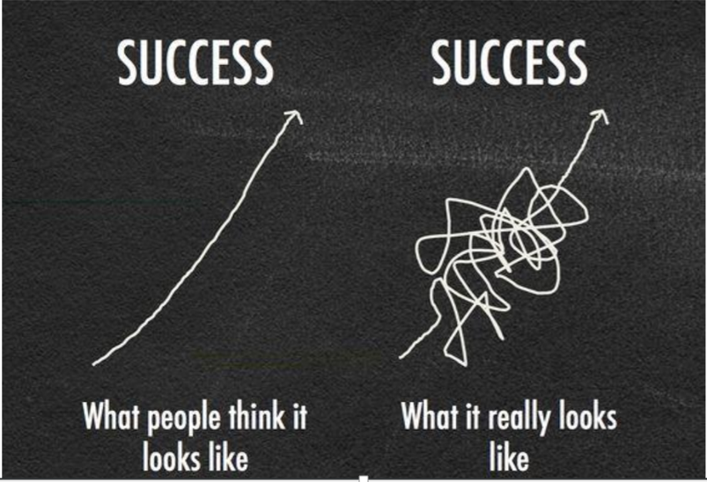
Embrace the scrambled mess…it’s worth it!

Slide 16
Defining Social and Emotional Needs
Social and emotional needs are at the heart of well-being and the foundation for achievement for all children. Many gifted children need targeted assistance with peer relationships, perfectionism, asynchronous development, situational stressors, and rationale post secondary planning.

Slide 17
Social & Emotional Needs of the Gifted
While gifted students look perfect on paper, they require a special understanding of their social and emotional needs. We MUST be aware of these needs.
Be aware that strengths and potential problems can be flip sides of the same coin. (Strength: diverse interests and abilities; Potential Problem: may appear disorganized or scattered; frustrated over lack of time)
Gifted students’ physical, emotional, social and intellectual growth is often uneven
Gifted students are likely to, at some point, doubt that they are actually gifted.
Gifted students may face social challenges not just from peers, but parents and teachers as well.
As they get older, gifted students may take fewer risks to preserve their perceived perfection.
Gifted students can have surprisingly heightened emotional sensitivity.
Some gifted students are introverted and mistake that for shyness
Gifted students’ abstract intuition may conflict with teachers’ desire for concrete thinking.
Gifted students needs can not be met by only individual learning

Slide 18
Here at Sunset Park…
Help students recognize their strengths and their weaknesses. Show them how to use their strengths to develop their weak areas or find learning partners who are strong in areas where they may be weak.
Provide descriptive, accurate, and constructive feedback that focuses on how students can develop themselves in specific tasks or skill areas.
Focus praise on the effort students put forth toward a goal.
Offer authentic challenges on issues they or others care about that will take time, effort, and persistence to solve.
Teach specific skills of studying, organization, metacognition, time management, goal setting, and monitoring.
Use pre-assessments to help students recognize what they already know/understand and are able to do, and what they don’t know/understand and are not yet able to do.
When teaching discrete strategies, show students how using the strategy will help them develop certain skills. Some gifted students are whole to part learners and may avoid practicing discrete strategies (part) if they don’t understand how it leads to greater skill development (whole).
Structure time throughout the day when students can reflect on their learning process, talk with others about tasks that were easy or difficult, or take note of their personal feelings on the topic.
Create learning activities where students will need to rely on others to complete the tasks. In these “unlike” groups, students learn to appreciate other people’s skills and realize they have skills unique to themselves.
Continually support students by showing them how their efforts lead to success

Slide 19
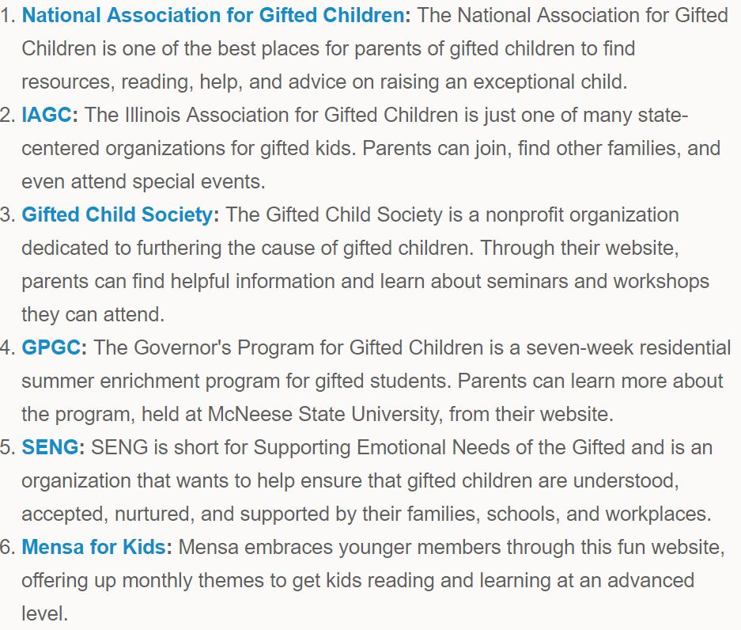
Resources available…

Slide 20
Presentation Resources
VanTassel-Baska J, Olszewski-Kubilius P, Kulieke M. 1994. A study of self-concept and social support in advantaged and disadvantaged seventh and eighth grade gifted students. Roeper Rev. 16:186-91
Powerpoint presentation, Dr. Harriet Jaworowski, CIGT Spring 2018, Feb 6, 2018.
National Association for Gifted Children, website
http://www.nagc.org/resources-publications/resources-parents
Carol Dweck, The Development of Giftedness and Talent Across the Life Span.
Dweck, C. (2015) Carol Dweck Revisits the “Growth Mindset”. Education Week.

