Slide 1
Reducing the Covid Slide
What is the Covid Slide?
How can parents help?
Parents – Monitor grades through Canvas

Slide 2
What is the Covid Slide?
Since its outbreak two years ago, the COVID-19 pandemic has disrupted education systems globally, affecting the most vulnerable learners the hardest. Thus, the achievement gap has increased. Schools were closed in March 2019 and reopened in late September 2019, which meant no school for sixth months.

Slide 3
The Northwest Evaluation Association (NWEA) MAPS
Summer Slide – students lose
    15-30 percent of gains in math
    5-15 percent of gains in reading
Covid Slide – students lost
    More than 50% in math
    More than 30% in reading
    Collaborative-Brief_Covid19-Slide-APR20.pdf
Parents and teachers must work together!

Slide 4
Teachers need Parents
Establish consistent routines at home to improve their time management skills. Have a set time to do homework, chores, and etc.
Teach your child the importance of having a growth mindset. Model this by demonstrating persistence when faced with a challenge.
Attendance is important. Avoid absences if children are not sick.
Engage in conversations with your child often. Simply conversing with your child can teach them about good communication skills.
Show your child that education is important! Be aware of grades, consistently discuss progress, always study with them, and review tests results!
Promote Reading by reading with your child on a regular basis.

Slide 5
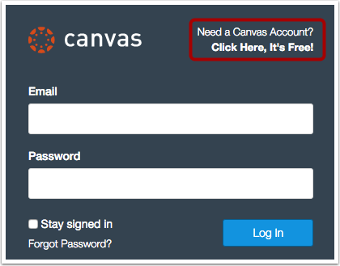
Accessing Canvas https://rockhill.instructure.com/login/canvas

Slide 6
Accessing Canvas https://rockhill.instructure.com/login/canvas
Enter your name in the name field (1).
Enter your email in the email field (2).
Enter your child's username in the child's username field (3) (for third to seventh grades, this is First Initial, Last Initial, then last five digits of the lunch code for example CM12345; for eighth through twelfth grades, use the entire PowerSchool number). You can call your child's teacher for assistance with this.
Enter your child's password in the child's password field (4). For all students this is the eight digits of their birthdate MMDDYYYY.
Agree to the terms of use by clicking the You agree to the terms of use check box (5).
Click the Start Participating button (6).

Slide 7
Questions that Parents Should Ask
1. May I tell you about my child?
2. May I tell you about what’s going on at home?
3. How is my child doing emotionally?
4. How is my child doing socially?
5. What are my child’s academic strengths and weaknesses?
6. Is my child performing on grade level?

Slide 8
Questions Continued
7. What do academic performance assessments mean?
8. Does my child need extra help in any areas?
9. May I share a concern?
10. Can you fill me in on a particular situation?
11. How can I help at home to support what you’re doing in the classroom?
12. What’s the best way to communicate with you?
We can reduce the slide, but we must work together to do it!

Slide 9
MAPS Reports
file:///C:/Users/SGayton/Downloads/Language%20Arts%20Reading.pdf

Slide 10
Resources https://www.fldoe.org/em-response/resources-families.stml
Character counts - http://www.charactercounts.org/ - resources to build character and learning activities for parents to do at home.
Free math activities- https://www.fldoe.org/em-response/resources-families.stml#:~:text=while%20at%20home.-,Dads%20Worksheets,-DadsWorksheets.com%20has
Khan Academy - https://www.khanacademy.org/ - free lessons
Nasa - https://images.nasa.gov/search-results?q=star&page=1&media=image,video,audio&earStart=1920&yearEnd=2020- - free video library
Storyline Online - https://storylineonline.net/ - stories read aloud by actors
Hand2mind - https://www.hand2mind.com/lessons – K15 math/science/literacy

Slide 11
Developing a Growth Mindset
https://www.verywellfamily.com/tips-for-teaching-your-child-to-have-a-growth-mindset-4014842
https://www.youtube.com/watch?v=rUJkbWNnNy4

Slide 12
Question Time
???

