Slide 1


Slide 2
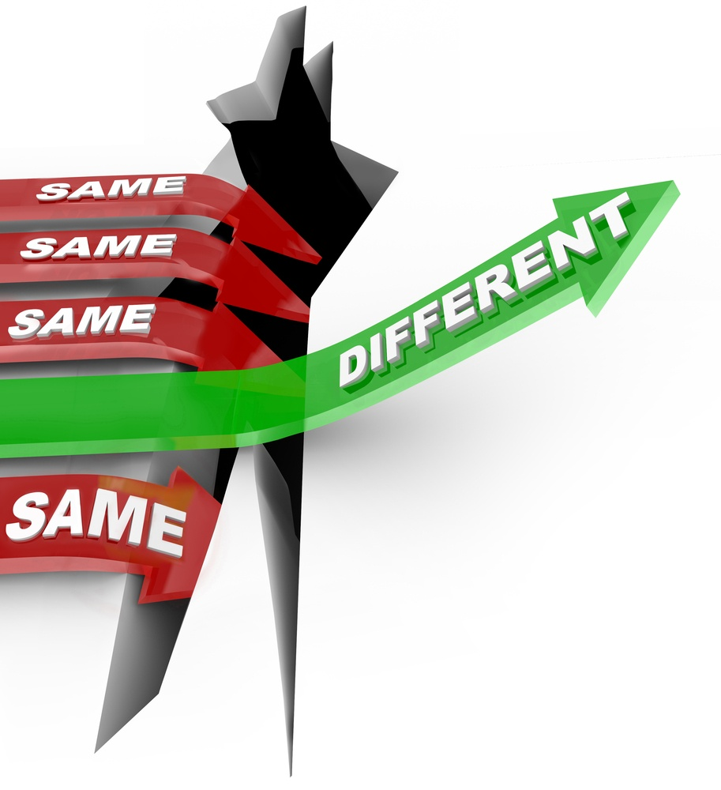
Fostering A Growth Mindset
Dr. April McConneaughey, MTSS Academic Interventionist
Sunset Park Center for Accelerated Studies

Slide 3
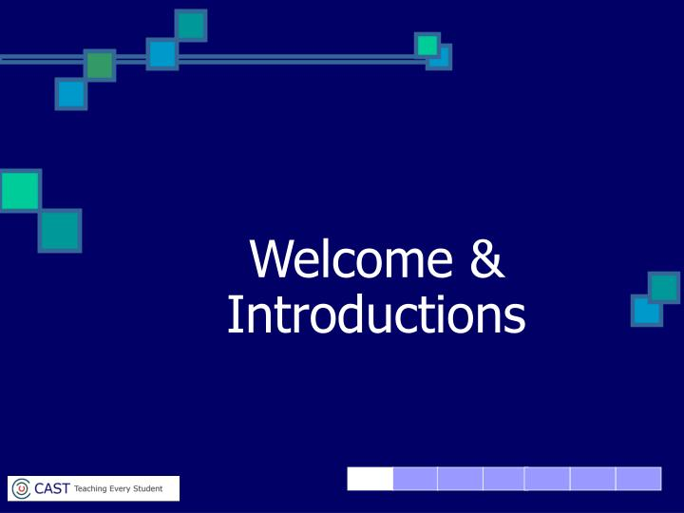

Slide 4
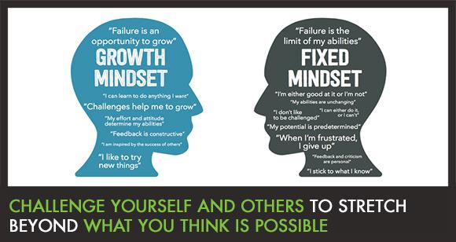

Slide 5

Let’s Get Started

Slide 6
“ Learning Outcomes”
Parents will be able to:
Develop strategies using a Growth Mindset that will help empower
their child(ren) to take responsibility for their own learning
Create and sustain a viable homework environment that is based on
dedication and hard work rather than on brains and talent
Foster their child(ren)’s growth and proficiency by utilizing a Growth Mindset
Maintain a daily framework to foster an interest in learning new things
and looking for opportunities to grow

Slide 7

SCHEIN’S DEFINTION OF CULTURE
“A pattern of shared basic assumptions learned by a group as it solves problems of external adaptation and internal integration (…)
A product of joint learning”.

Slide 8

SCHEIN CONTINUED
Artifacts
Espoused Values
Goals and Philosophies

Slide 9
School Culture
  Beliefs
  Values
  Attitudes
  Behaviors
  Results

Slide 10
Self- Efficacy
Psychologist Albert Bandura has defined self-efficacy as one's belief in one's ability to succeed in specific situations or accomplish a task”. According to Bandura,
one's sense of self-efficacy can play a major role in how one approaches goals, tasks, and challenges. specific situations or accomplish a task”.

Slide 11
Mindset and Effort
Fixed Mindset
Growth Mindset
View effort as useless, or as proof of one’s lack of innate ability.
Believe that effort is for those who are not fortunate enough to be “smart” or naturally talented.
See effort as a path to mastery.
Effort is viewed as something necessary to grow and master useful skills.

Slide 12
Something to Thing About
“The most important reason for going from one
place to another is to see what's in between.”
Norton Juster

Slide 13


Application

Slide 14
Fixed vs. Growth Mindset
Fixed Mindset
Growth Mindset
Students believe their basic abilities, their intelligence, and talents are fixed traits.
Students believe failure is an opportunity to grow, challenges help me to grow. The mindset of these students is I like to try new things.

Slide 15
Fixed vs. Growth Mindset
Fixed Mixed Mindset
Growth Mindset
Primary desire is to appear
“smart: or able to do a task
Which leads to:
Avoidance of Challenges
Primary desire is to improve
Which leads to:
Embracing Challenges

Slide 16

Communicating with students using a Growth Mindset
Set high expectations with the belief that the student with hard work
will be able to achieve them.
Help the student understand that there are no shortcuts or magic.
Share the truth and provide the student with strategies to help them continue to make progress.
I am going to help you learn
( Rather than I am assessing you based on your talent and abilities.)

Slide 17
Communication to Avoid
“ You did that in such a short period of time.” “ you are really smart!”
“ You are a natural at ________________.”
“ You really are creative, athletic.”

Slide 18

Putting it all together!

Slide 19
How to help students respond to setbacks
I noticed that you missed some words on your vocabulary quiz. Do you have any ideas on how you might be able learn your assigned vocabulary words better next week?
When you completed your math homework assignment yesterday, I noticed that you were a little frustrated. Let’s make a list of some things that will help you enjoy the time that you have to practice new concepts that you learn in math and other subjects.

Slide 20
Effective Communication using a
Growth Mindset
Focus on the process
Remember when you first started ___________ and you could only
__________? After you worked hard you learned how
to ______________.
You worked really hard on the math project. I think that you did a
great job with the challenge and you will continue to learn even when
things !

Slide 21
Exposure to Words
Percentile Rank | Minutes Reading/Day | Words Read/Year
98 | 65 | 4,358,000
90 | 21.1 | 1,823,000
80 | 14.2 | 1,146,000
50 | 4.6 | 282,000
20 | .7 | 21,000

Slide 22

Reflection

Slide 23
Areas for Future Study
The impact that utilizing a Growth Mindset has on parent, student, and teacher relationships
The correlation between school culture and student performance
The interconnectedness relative to parental partnerships and continual student progress

Slide 24

Chat Discussion

Slide 25
“One's journey never ends at a place, instead it is an ongoing process that involves a new way of seeing things.”
Author Unknown

Slide 26


Slide 27
REFERENCES
Antonoucci, M. (2001) Teacher Inquiries in Literacy Teaching-Learning: Learning to Collaborate in Elementary Classrooms. Language Arts, (79.2) ,171.
Best Practices in K-12 Literacy Models, 2014, Hanover Research/District Administration Practice.
Dweck, C.S. (2000) Essays in Social Psychology : Self Theories, New York, Psychology Press
Dweck, C.S (2006) Mindset: The New Psychology of Success, New York: Random House
https://www.youtube.com/watch?v=M1CHPnZfFmU&vl=en
Schein, E. ( 2010) Organizational Culture and Leadership, San Francisco, Jossey
Senge, P. (2006) The Fifth Discipline,, New York, Doubleday/Currency
One Team. One Mission. One Rock Hill.

Slide 28
Contact Information
AMcConneaughey@rhmail.org
980-553-1365

